Slide 1
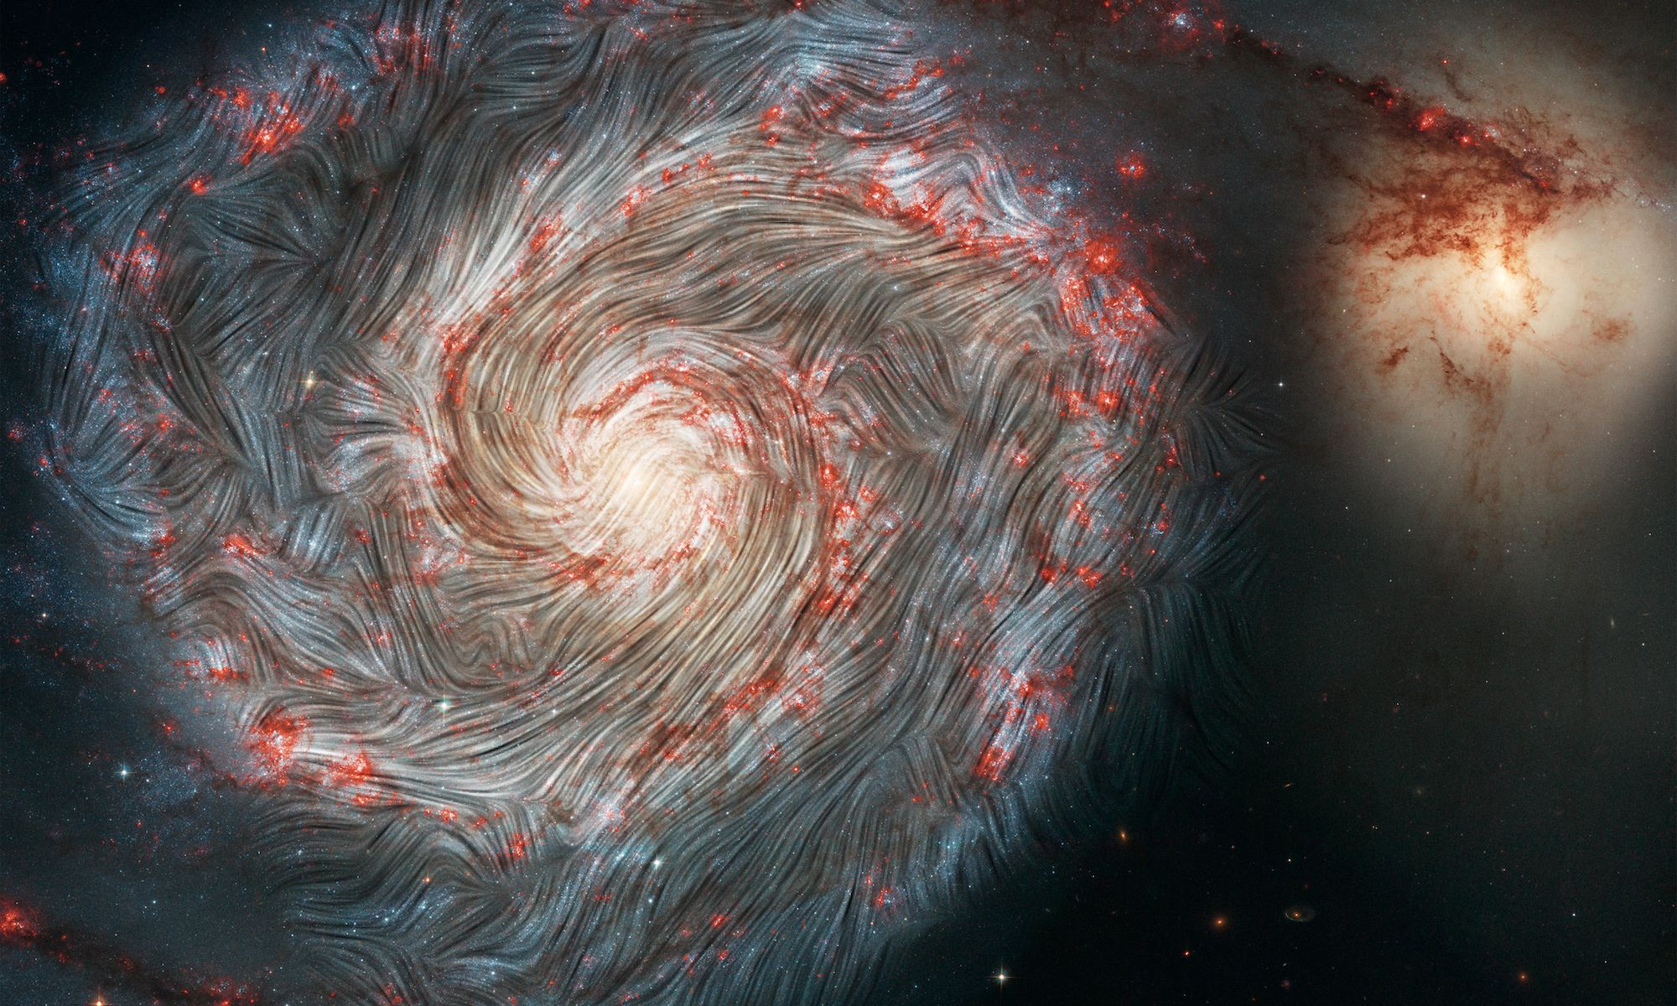
Laboratory Plasma Astrophysics
Theory and Selected Topics
Introduction to Plasma and Fusion Course, Princeton Plasma Physics Laboratory, 6th of June 2025.
Vicente Valenzuela-Villaseca*
Postdoctoral Research Associate
Department of Astrophysical Sciences, Princeton University
*Moving to Lawrence Livermore National Laboratory and MIT in August

Slide 2
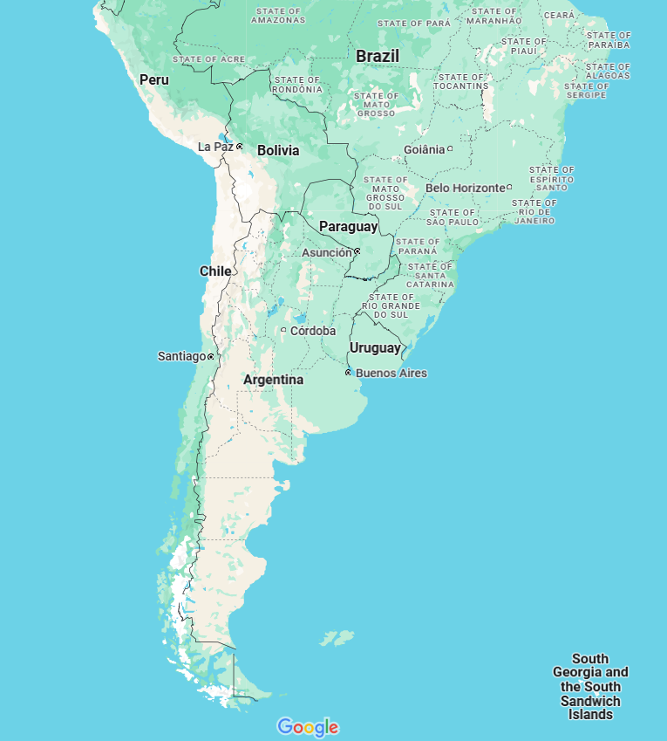
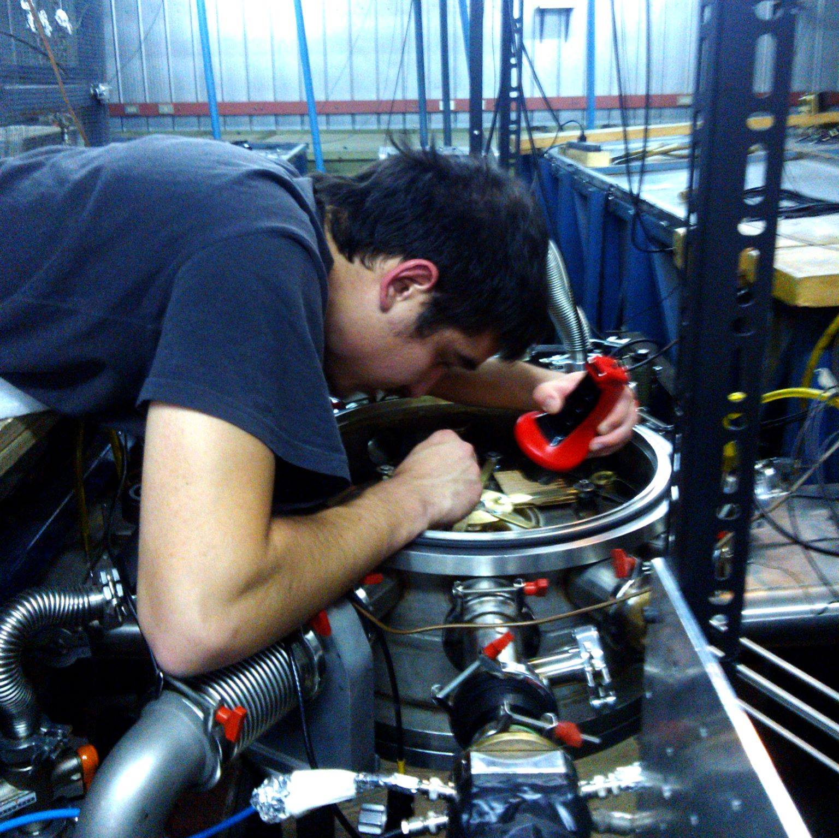
A little bit about me…
Young me setting up a pulsed-power conical jet experiment in 2014

Slide 3

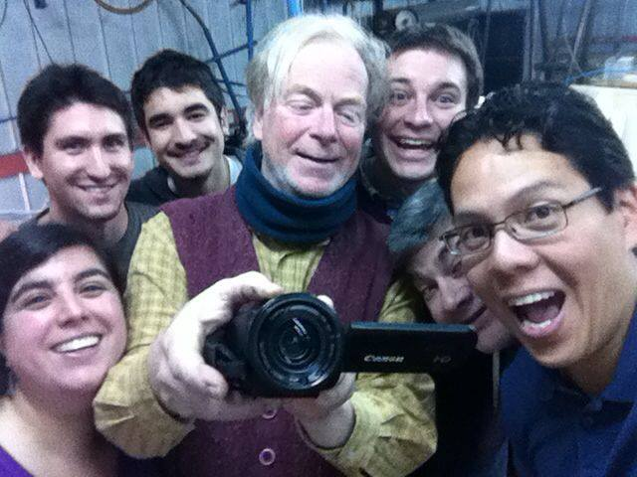
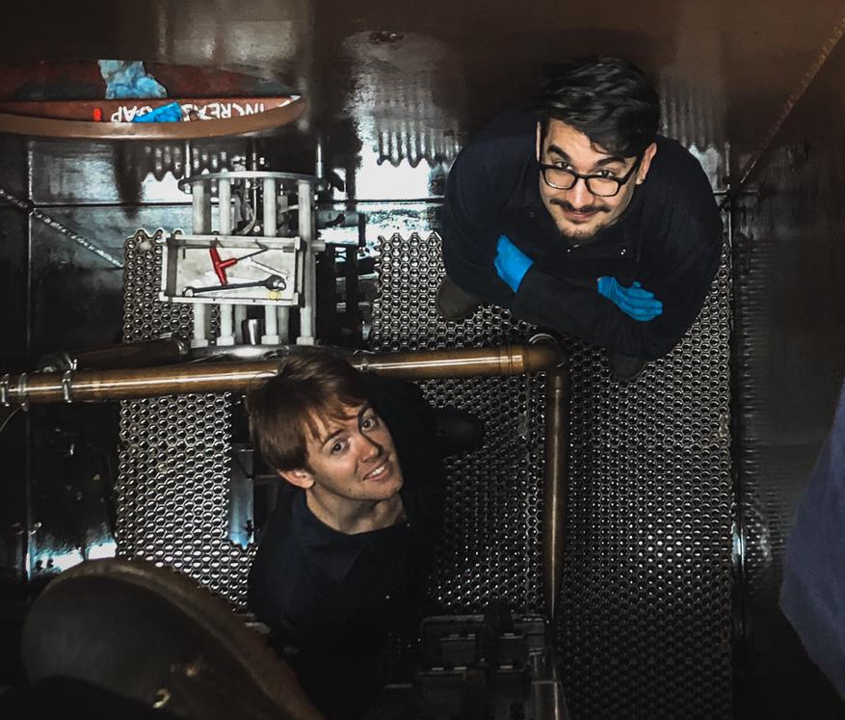
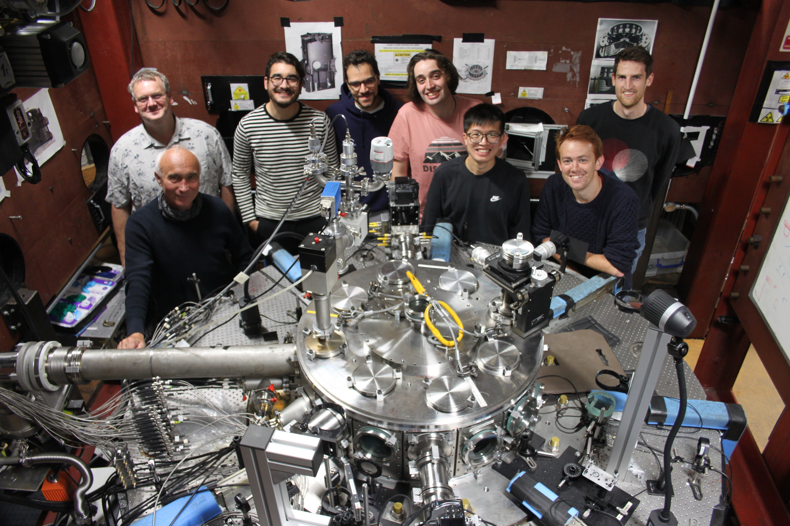
A little bit about me…
Started as an astronomy student
In January 2013 I joined the plasma physics lab at my university in Chile
Fell in love with experimental plasma physics
In 2018, I moved to London to do my PhD at Imperial College
In 2022, I moved to Princeton Astrophysics as a postdoc
Now I’m off to Livermore to kickstart my own research program, combining theory and experiments

Slide 4
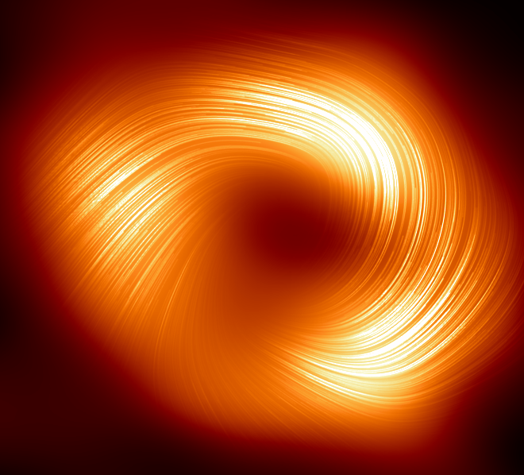
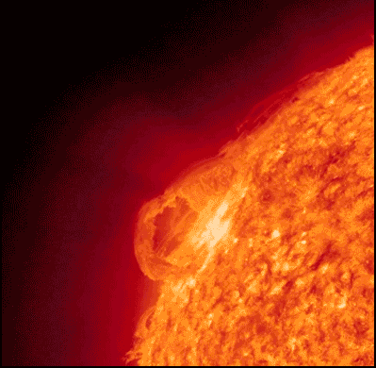
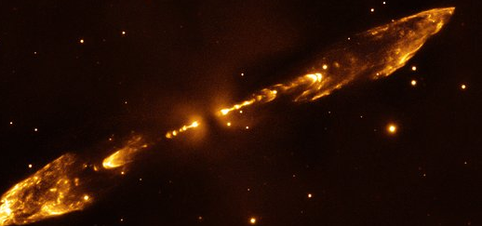
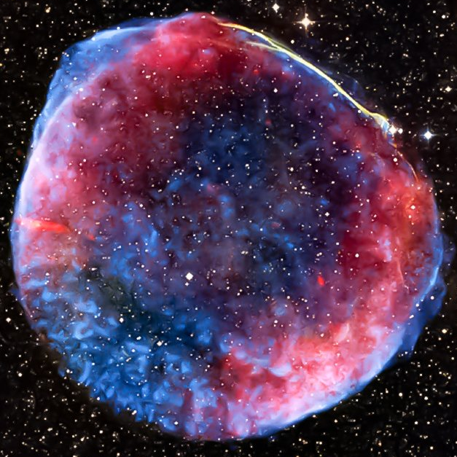
The universe is magnetic
The Whirlpool galaxy and its magnetic fields
Stellar flares
Accretion discs
Protostellar jets
Plasma phenomena are everywhere in the cosmos!
Supernovae
Credit: NASA, SOFIA, ESA, STScI
Motivation: a magnetized universe

Slide 5
Outline
Plasma Astrophysics: Why is it important? Why is it difficult?
Laboratory Plasma Astrophysics: What is it? Where do we do it?
Theory of MHD scaling: From the cosmos to the lab
  When can a plasma be treated as a fluid?
  Dimensionless parameters and their meaning
Selected topics
  Plasma jets and radiative/MHD instabilities
  Turbulence and magnetic dynamo
  Magnetic reconnection and plasmoids
  Subcritical MHD shocks and collisionless magnetized shocks

Slide 6
Laboratory Astrophysics with high-energy density (HED) facilities
Laboratory data providing important input parameters for astrophysical modelling
  Spectral lines, excitation rates, recombination rates, etc. – “traditional” laboratory astrophysics
  Properties of matter in extreme conditions (temperature, density, pressure, etc) – e.g opacity, equation of state, warm dense matter
Dynamical laboratory experiments:
  Benchmarking hydrodynamics (compressible), radiation-hydrodynamics, magneto-hydrodynamics codes under scalable conditions
  Laboratory experiments may prompt the emergence of new concepts
Topic of this lecture

Slide 7
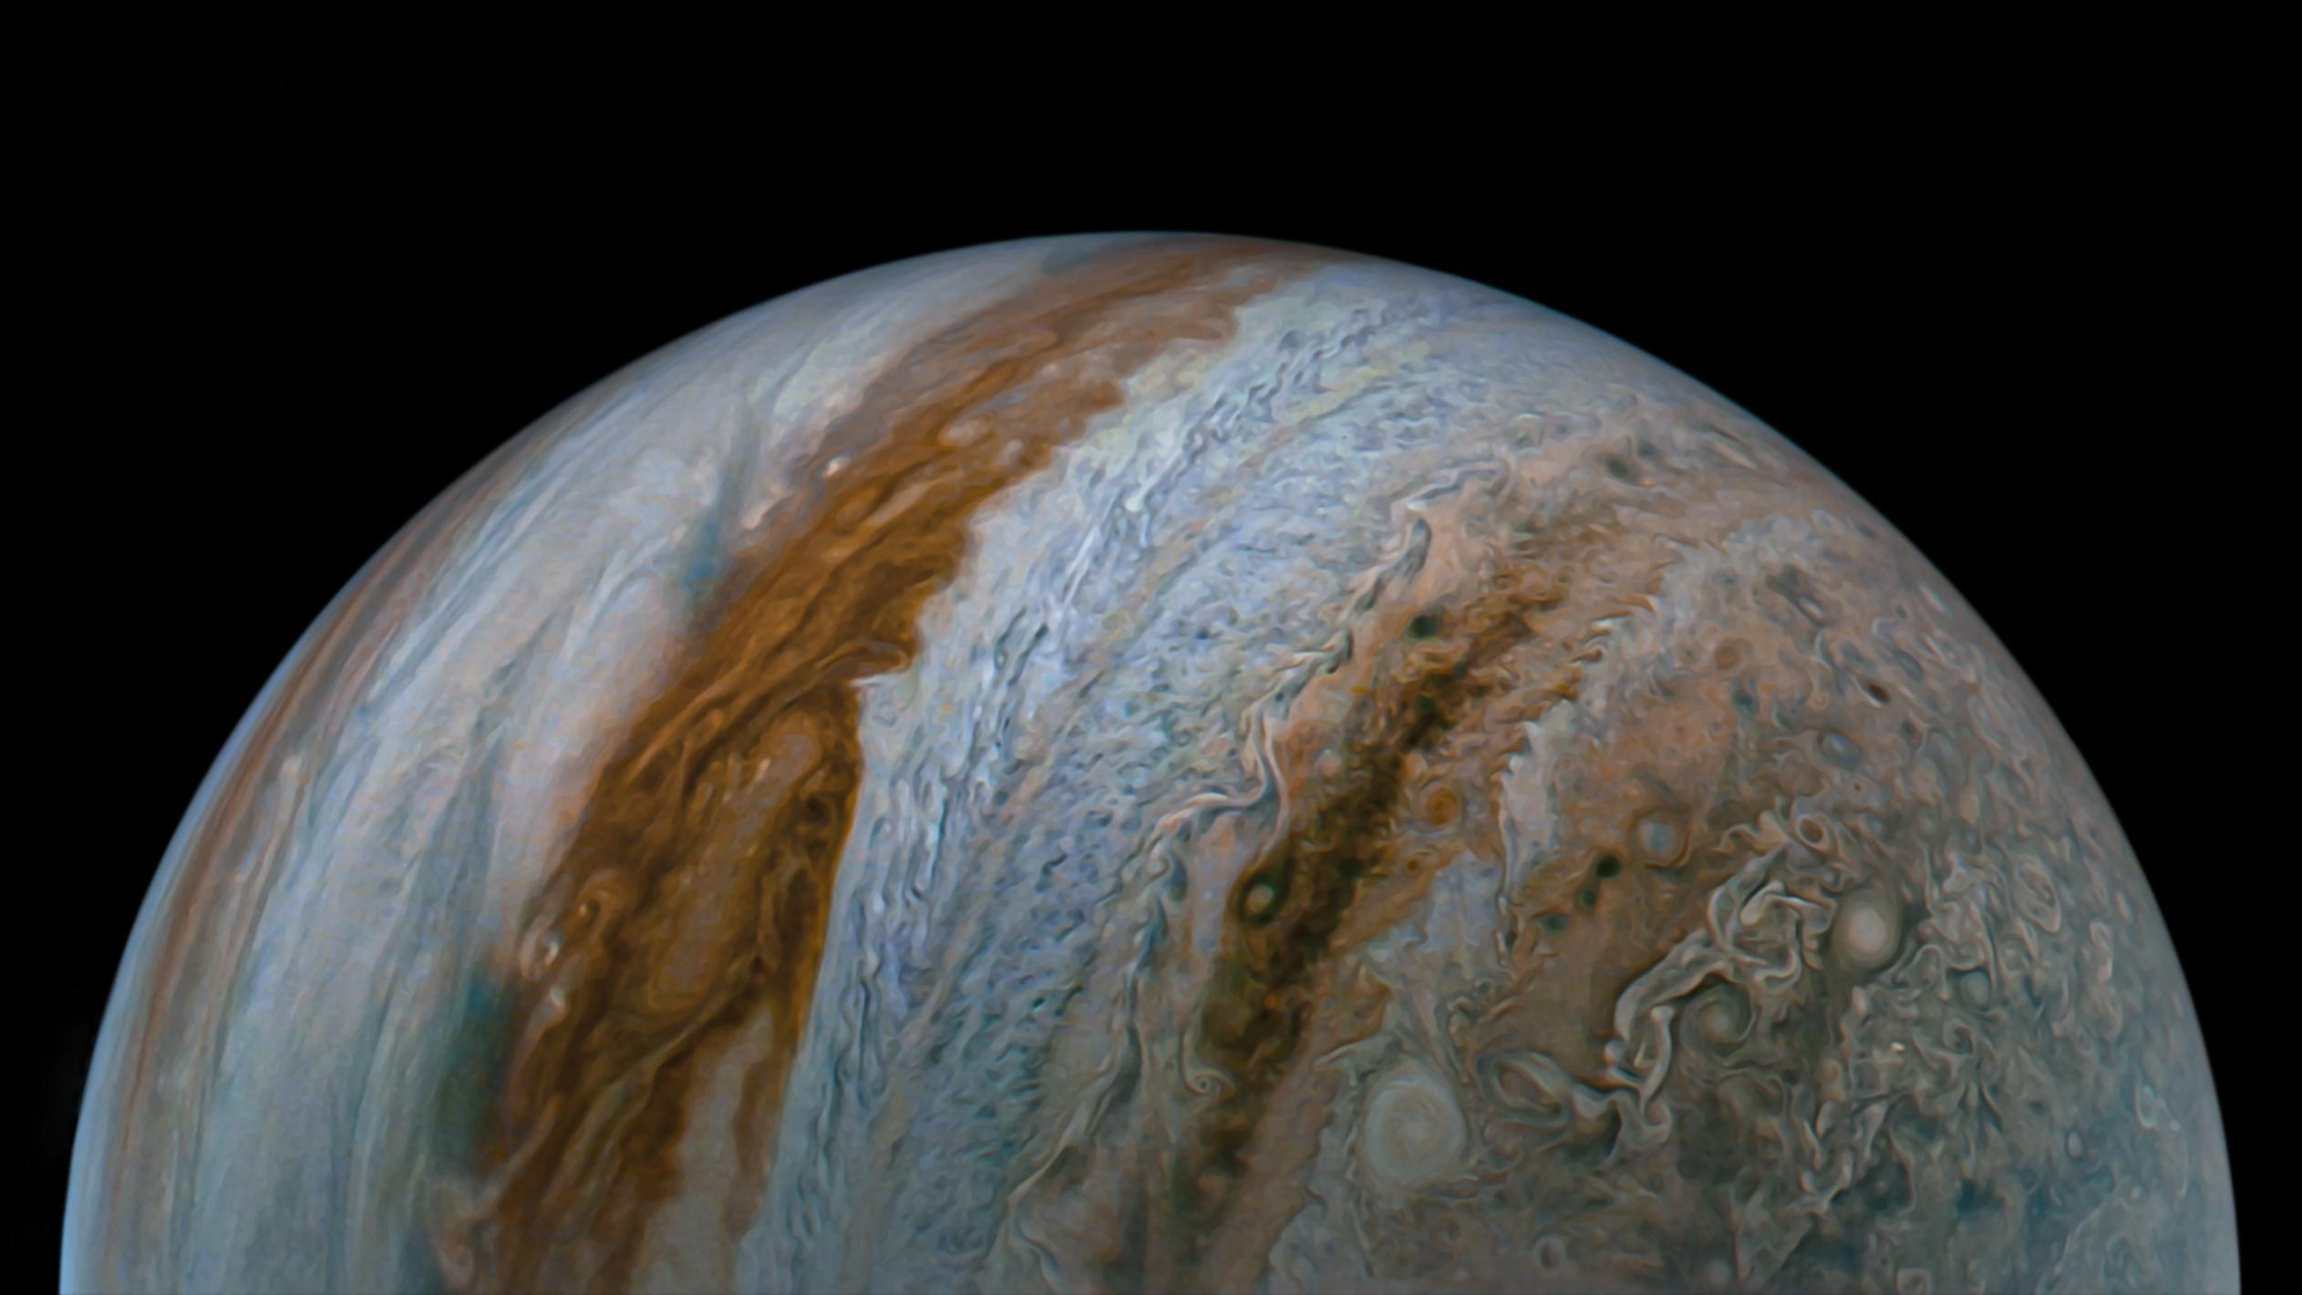
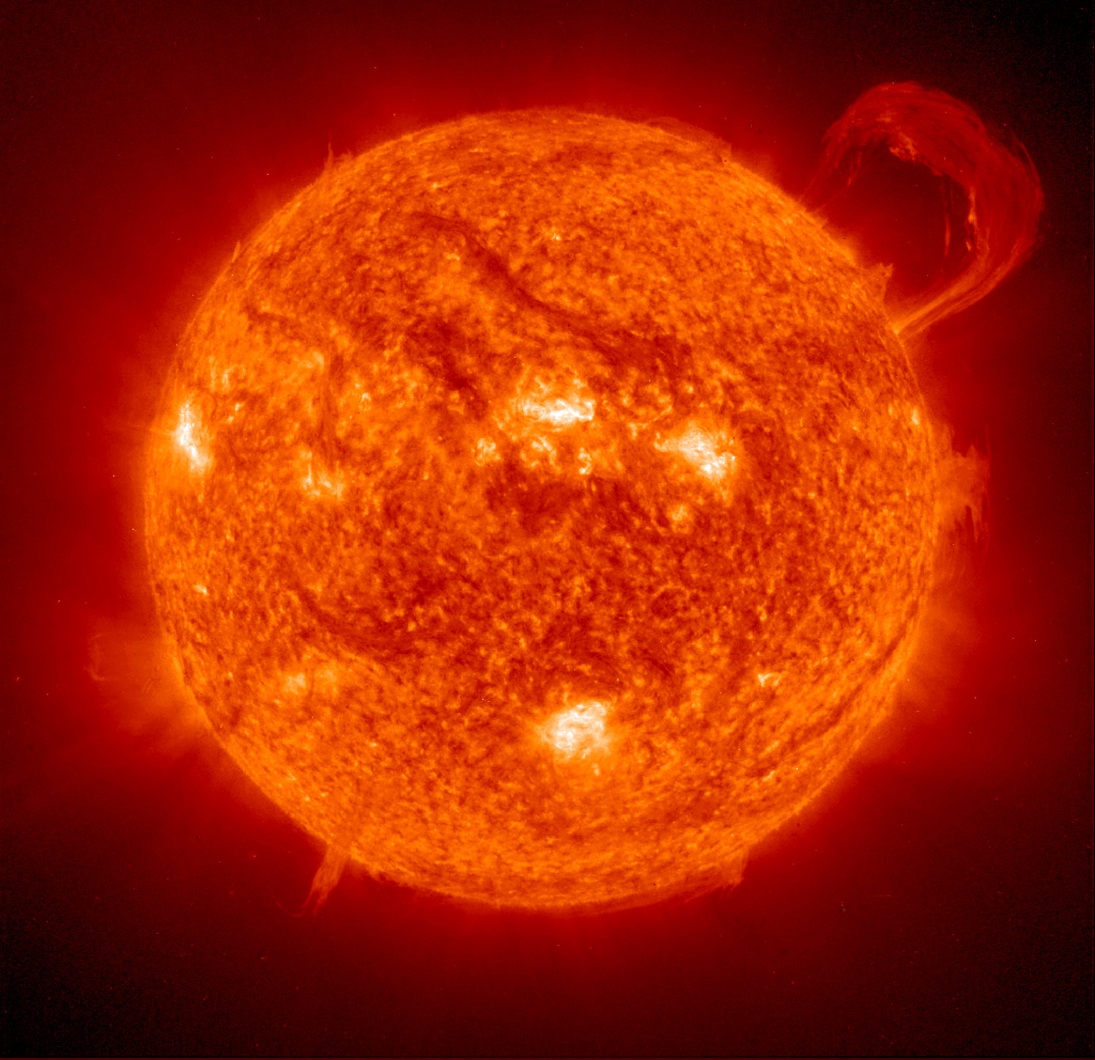
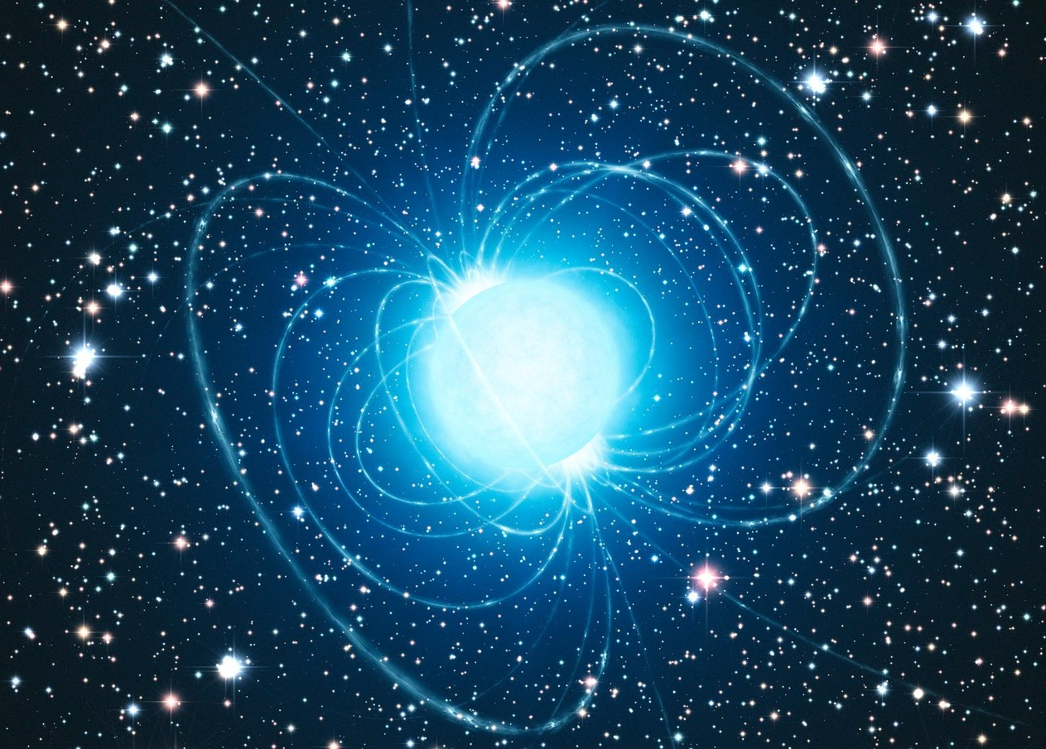
Plasma astrophysics deals with fluids, fields and particles and how they behave in the universe
Motivation: plasma astrophysics

Slide 8
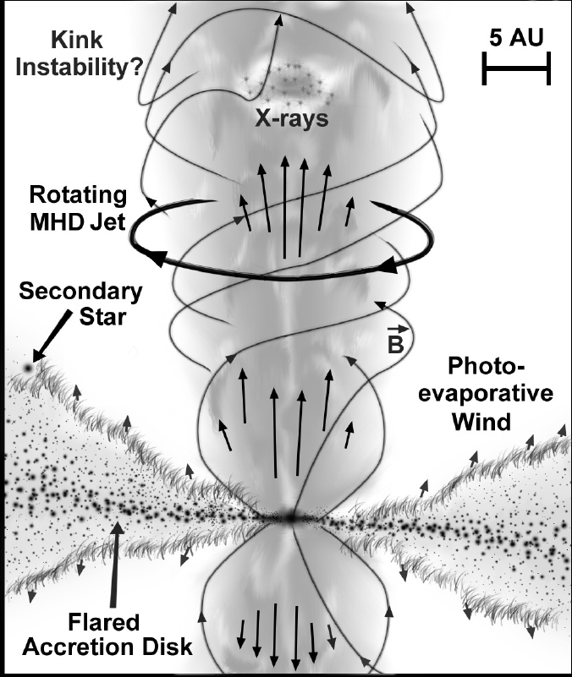
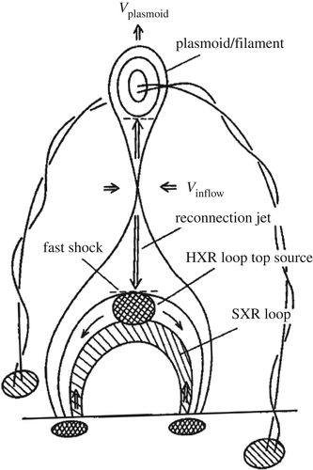
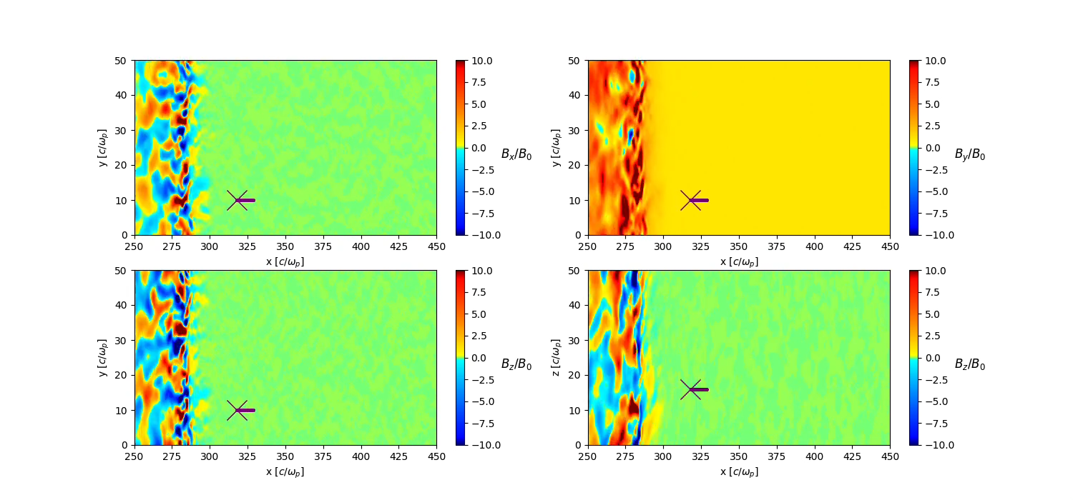
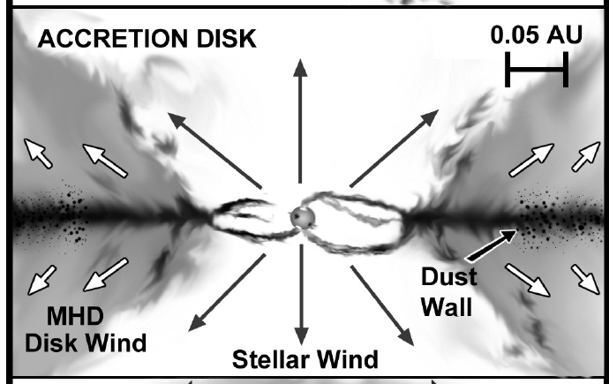
Fundamental processes in astrophysics are mediated by plasma effects
Accretion discs and jets
Coronal mass ejection
Cosmic ray acceleration in supernovae
Plasma physics is crucial for understanding
Formation and evolution of structures
Electromagnetic sources sources (e.g. stars, inter-stellar and -cluster medium, magnetospheres, compact objects)
Astro-particles (e.g. cosmic rays)
[Shibata+ 1995]
Motivation: plasma astrophysics

Slide 9
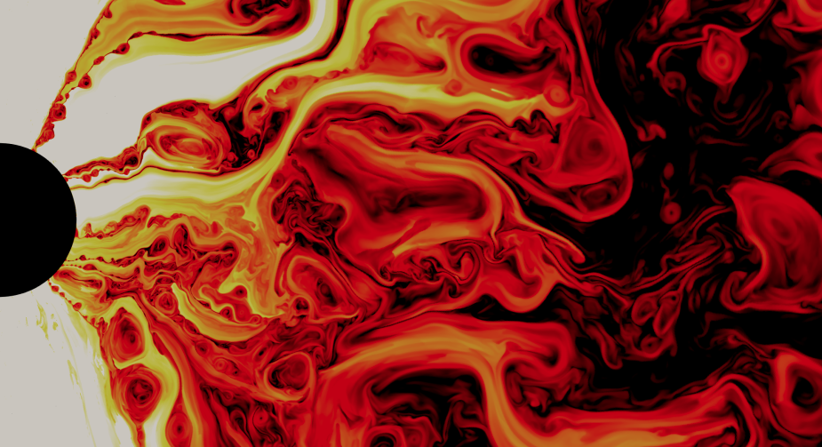
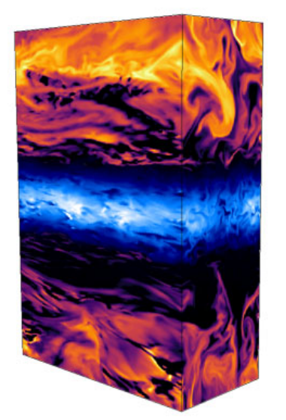
Plasmas often are highly dynamical, nonlinear, and multi-scale: hard to interpret observations and model!
Observation of Sgr A* in the Milky Way
Global simulation of a turbulent black hole accretion disc
Local simulation of a turbulent black hole accretion disc
Credit: Ripperda et al. (BHAC)
EHT Collaboration; Astrophys. J. (2024); Bambic et al., MNRAS (2024)
Motivation: plasma astrophysics

Slide 10
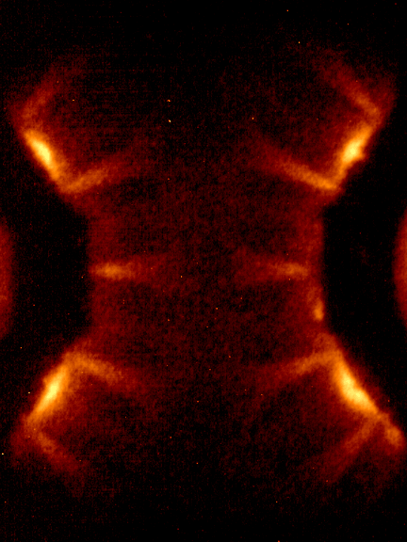
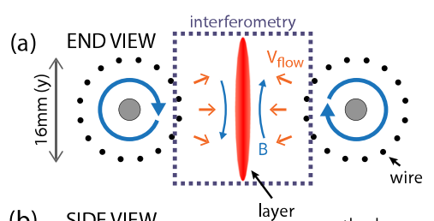
Laboratory Plasma Astrophysics: take a subset of an astrophysical problem and study it in detail
Experimental realization
Ex: Theory of a CMS on the Sun
Experimental concept
“Key” physics: magnetic reconnection
Reference (with hyperlink)
Introduction: laboratory plasma astrophysics

Slide 11
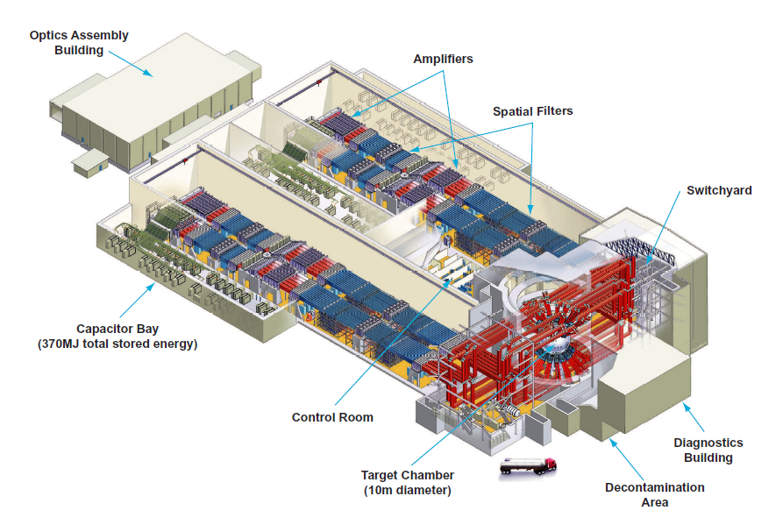
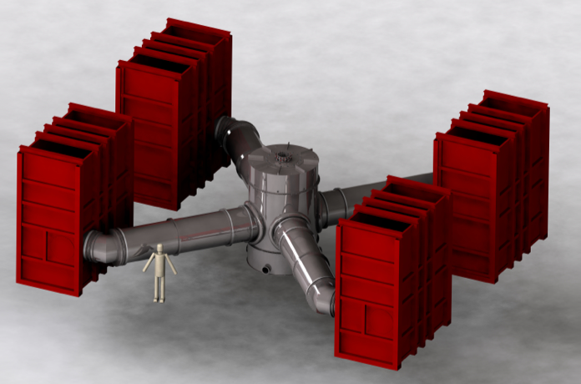
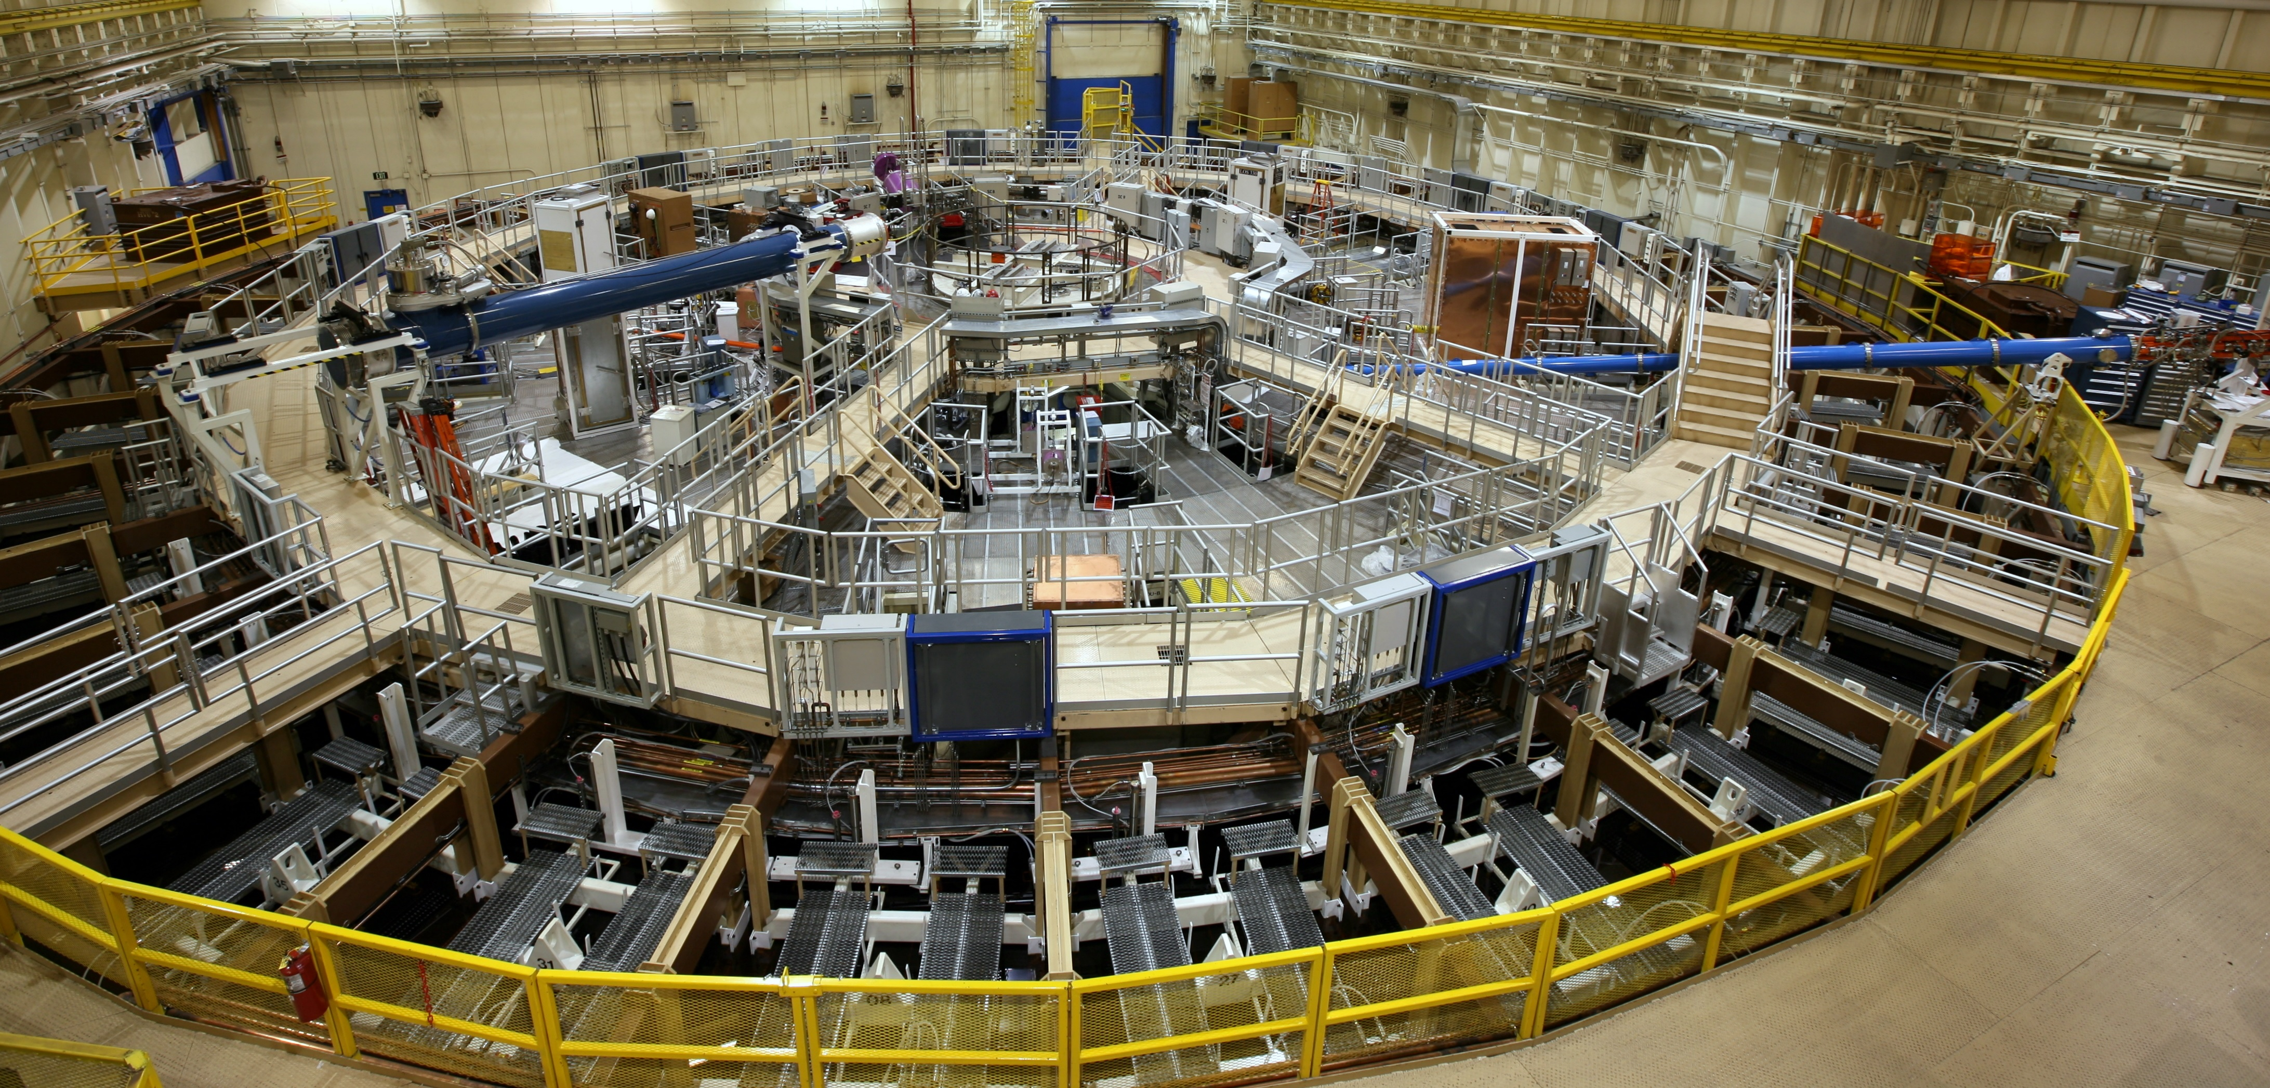
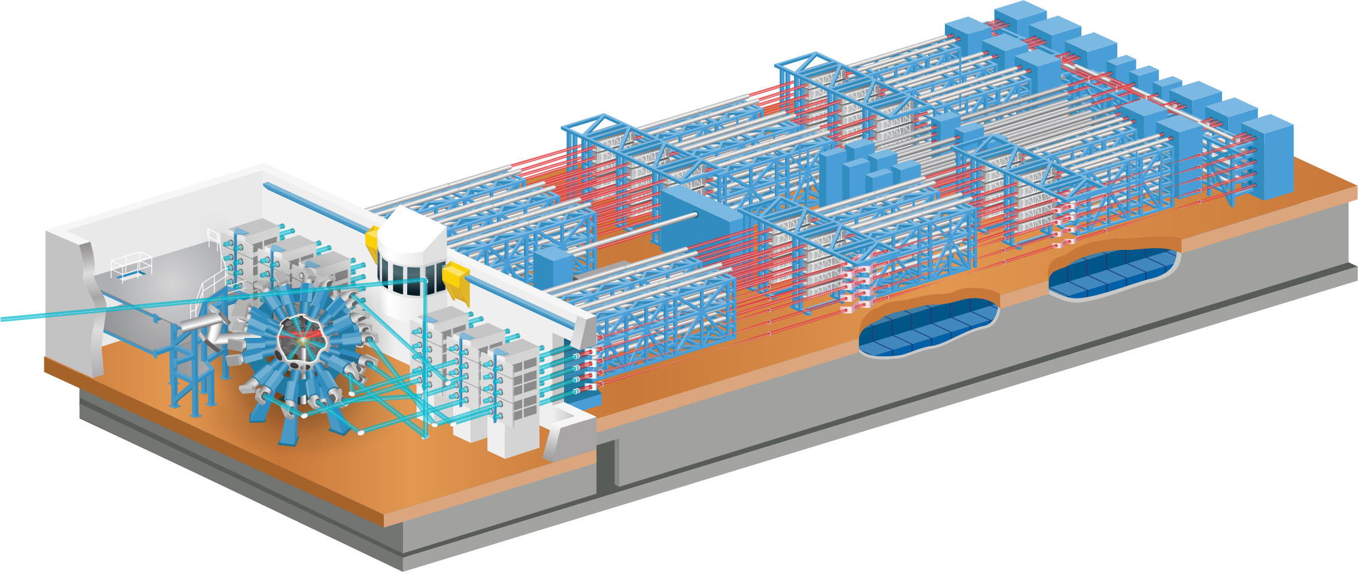
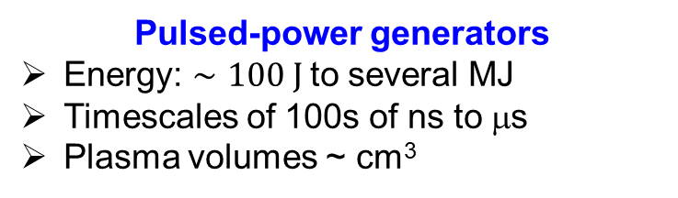
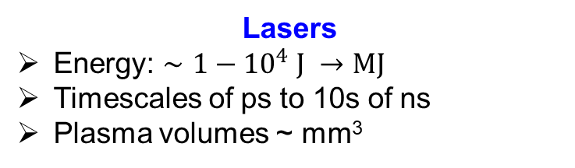
I work with dynamical laboratory astrophysics experiments on high-energy density facilities
High-energy density plasma (HEDP) facilities
Working definition: energy density $ε≥{10}^{12}$ erg cm⁻³; pressure $p ≥1$ Mbar
Lasers
Energy: $∼1−{10}^{4} J →MJ$
Timescales of ps to 10s of ns
Plasma volumes ~ mm³
Pulsed-power generators
Energy: $∼100 J$to several MJ
Timescales of 100s of ns to μs
Plasma volumes ~ cm³
Laser facilities: Vulcan (UK), LIL (France), FIREX (Japan), Omega (USA), NIF (USA), LMJ (France), etc
Pulsed-power facilities: Z-machine (USA), MAGPIE (UK), COBRA (USA), PUFFIN (USA), etc
NIF
Omega
Z
MAGPIE
Introduction: laboratory plasma astrophysics

Slide 12
Laboratory experiments are good for investigating fundamental physics of astrophysical objects in detail
Remington, Drake, Ryutov, Rev. Mod Phys., 2006
Astrophysical
System
Analytical / Numerical
Model
Laboratory
System
Study a subset of the problem
Make simplifying assumptions (symmetry, disregarding some “unimportant” physics)
Make educated guess on conditions / profiles
Study a subset of the problem
No simplifying assumptions (difficult to turn-off a physical package)
Control of initial conditions
Introduction: laboratory plasma astrophysics

Slide 13
Laboratory experiments are good for investigating fundamental physics of astrophysical objects in detail
Remington, Drake, Ryutov, Rev. Mod Phys., 2006
Astrophysical
System
Analytical / Numerical
Model
Laboratory
System
Scaled representation of astrophysical plasma dynamics:
Laboratory and astrophysical phenomena are described by the same set of equations
ideal MHD:
Rm >>1; Re >>1
Creating appropriate initial conditions (morphology)
Dimensionless numbers and similarity transformations
(M_{S}, M_{A}, β )
Lab experiment reproducing the evolution of an astrophysical system
Introduction: laboratory plasma astrophysics

Slide 14
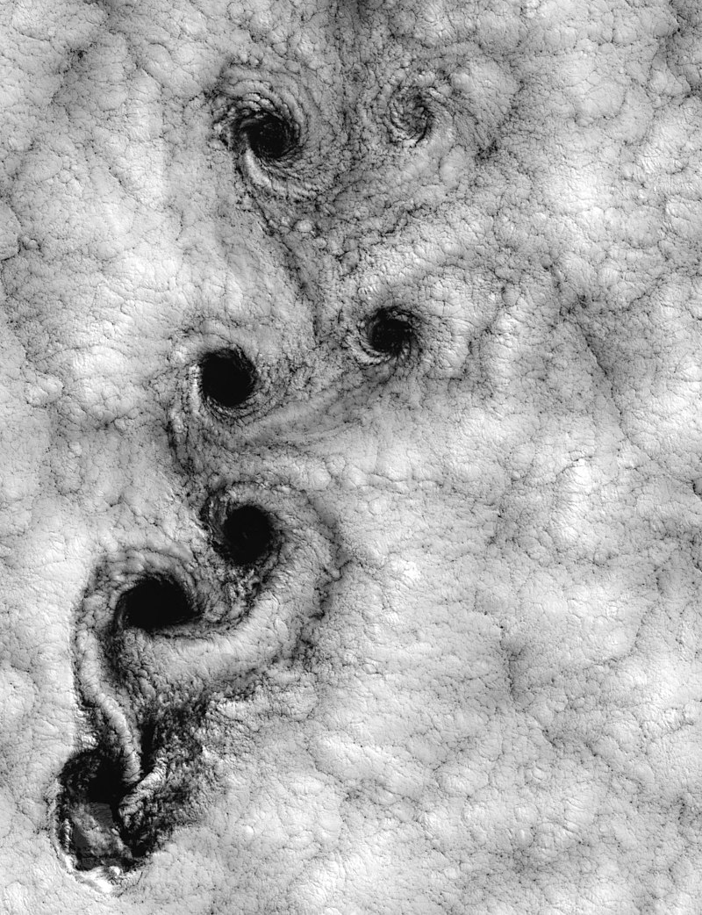
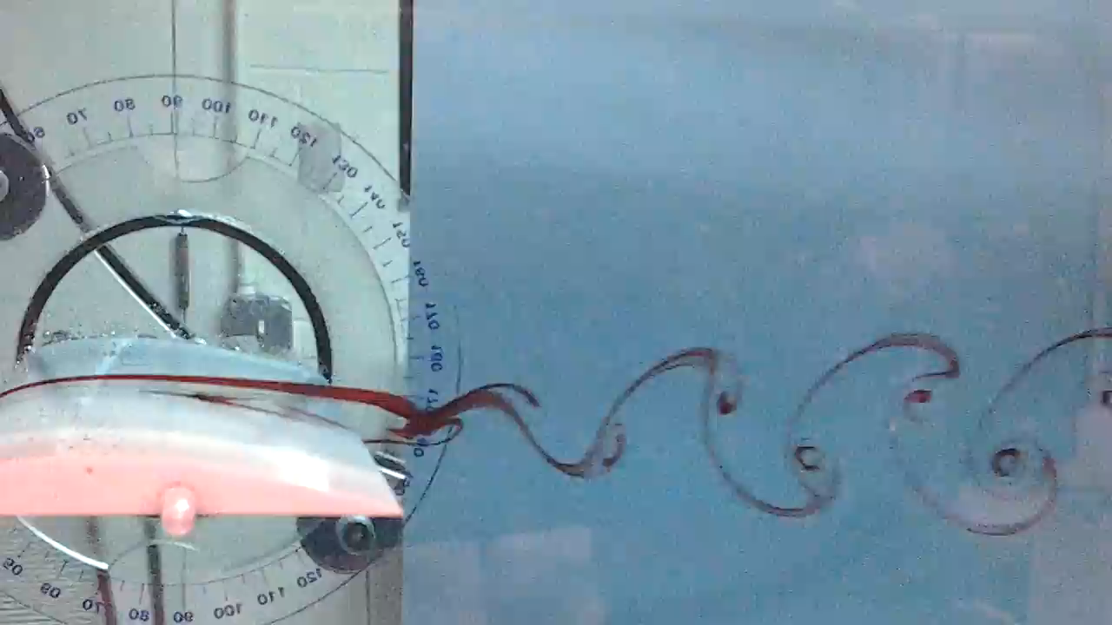
Hydrodynamic and magnetohydrodynamic flows often behave similarly despite their size
Von Karman vortex street in the atmosphere
Von Karman vortex street in a wind tunnel
Centimeters, seconds
Factor x10,000
Kilometers, hours
Credit: Sarwesh Narayan Parbat’s Youtube channel
Juan Fernandez Island (Chile)
Credit: Bob Cahalan (NASA)
Introduction: MHD scaling

Slide 15
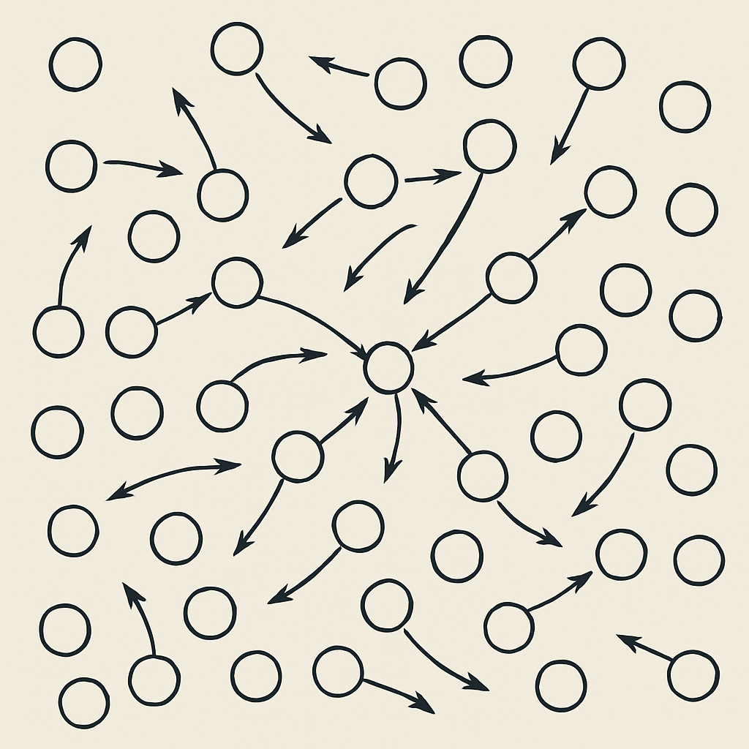
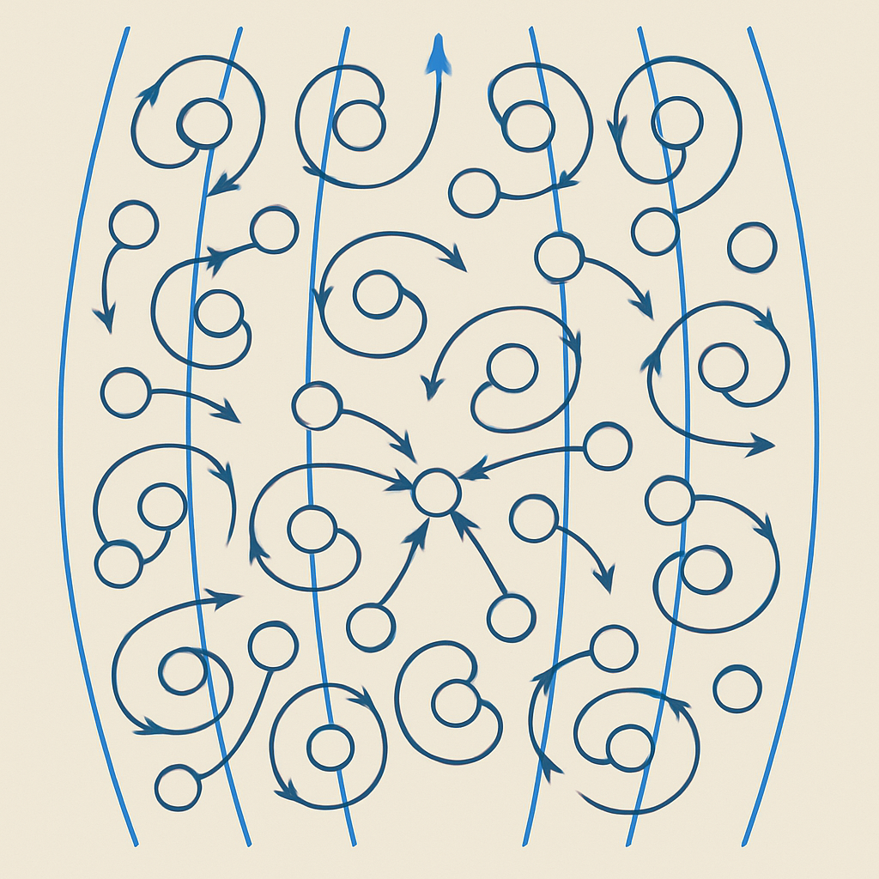
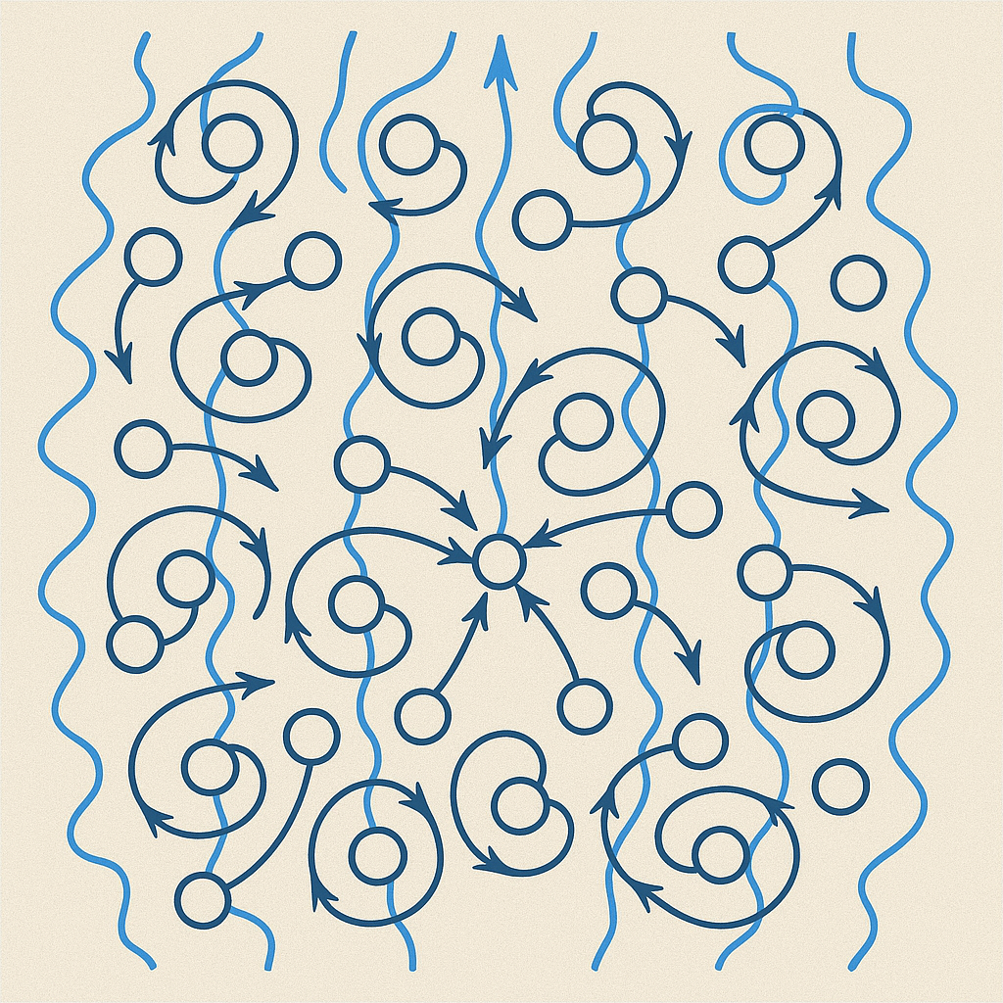
A plasma can be treated as a fluid when the particles within are localized
Collisional
Semi-collisional
Collisionless
Particle-particle collisions are efficient
Gyro-orbits are small
Particle-particle collisions are efficient along B-field
Gyro-orbits are small
Waves in the plasma efficiently pitch-angle scatter the particles (effective collisionality)
“Easy”. Use Braginskii theory.
Harder. Anisotropic. Can use Braginskii theory but handle with care.
Very hard. Possibly not universal. Handle case-by-case.
Braginskii, in: Review of Plasma Physics (1965); Marcowith et al., Rep. Prog. Phys. (2016); Kempski et al., Astrophys. J. (2025)
Introduction: MHD scaling

Slide 16
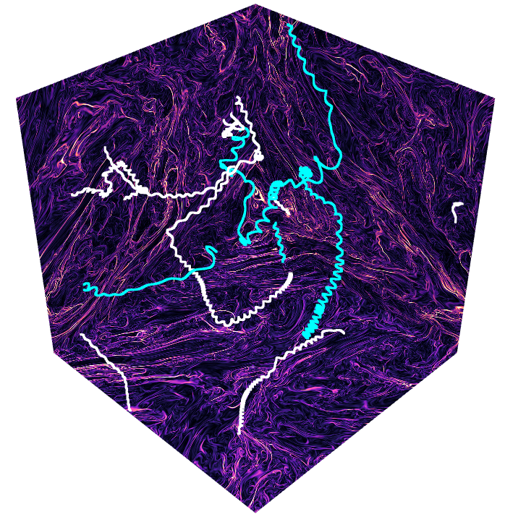
A plasma can be treated as a fluid when the particles within are localized
Collisional
Semi-collisional
Collisionless
Particle-particle collisions are efficient
Gyro-orbits are small
Particle-particle collisions are efficient along B-field
Gyro-orbits are small
Waves in the plasma efficiently pitch-angle scatter the particles (effective collisionality)
“Easy”. Use Braginskii theory.
Harder. Anisotropic. Can use Braginskii theory but handle with care.
Very hard. Possibly not universal. Handle case-by-case.
Braginskii, in: Review of Plasma Physics (1965); Marcowith et al., Rep. Prog. Phys. (2016); Kempski et al., Astrophys. J. (2025)
Introduction: MHD scaling

Slide 17
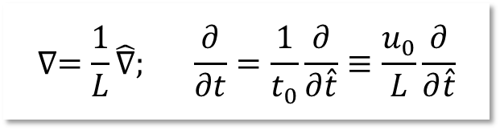

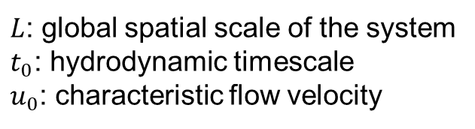
Let us write the MHD equations with explicit dependence on scale
Approach:
Write plasma and field quantities in terms of characteristic values and order-unity objects
Write differential operators using characteristic global spatial and temporal scales explicitly
Apply in all MHD equations
Solve such that left-hand-side of each equation such that it is dimensionless (only hat objects)
Fluid/field scalar
Fluid/field vector
$$λ=λ_{0}\hat{λ}; A=A_{0}\hat{A}$$
Characteristic value (with dimensions)
Order unity (dimensionless)
$$∇=\frac{1}{L}\hat{∇}; \frac{∂}{∂t}=\frac{1}{t_{0}}\frac{∂}{∂\hat{t}}≡\frac{u_{0}}{L}\frac{∂}{∂\hat{t}}$$
$L$: global spatial scale of the system
$t_{0}$: hydrodynamic timescale
$u_{0}$: characteristic flow velocity
Ryutov et al., Astrophys. J. (1999); Cross et al., Astrophys. J. (2016)
Theory: MHD scaling

Slide 18
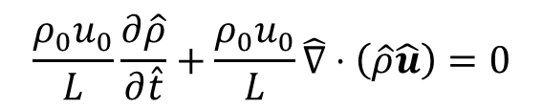
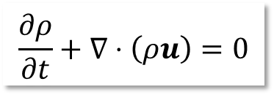
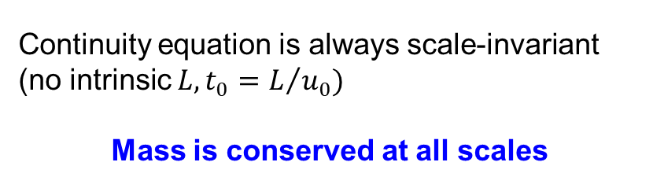
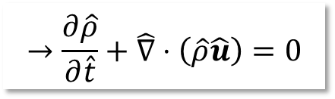
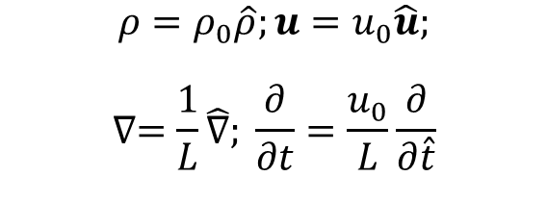
MHD scaling: continuity equation
$$\frac{∂ρ}{∂t}+∇⋅\left(ρu\right)=0$$
The conservation of mass is
$$ρ=ρ_{0}\hat{ρ};u=u_{0}\hat{u};$$
$$∇=\frac{1}{L}\hat{∇}; \frac{∂}{∂t}=\frac{u_{0}}{L}\frac{∂}{∂\hat{t}}$$
Fluid parameters
Introducing scaling variables
Differential operators
The continuity equation becomes
$$\frac{{ρ_{0}u}_{0}}{L}\frac{∂\hat{ρ}}{∂\hat{t}}+\frac{{ρ_{0}u}_{0}}{L}\hat{∇}⋅\left(\hat{ρ}\hat{u}\right)=0$$
$$→\frac{∂\hat{ρ}}{∂\hat{t}}+\hat{∇}⋅\left(\hat{ρ}\hat{u}\right)=0$$
Continuity equation is always scale-invariant (no intrinsic $L,t_{0}=L/{u_{0}})$
Mass is conserved at all scales
Ryutov et al., Astrophys. J. (1999); Cross et al., Astrophys. J. (2016)
Theory: MHD scaling

Slide 19
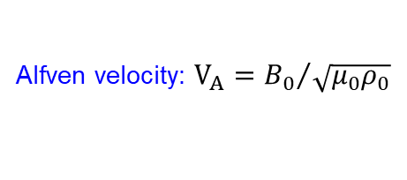
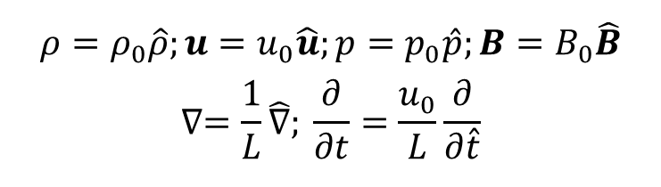
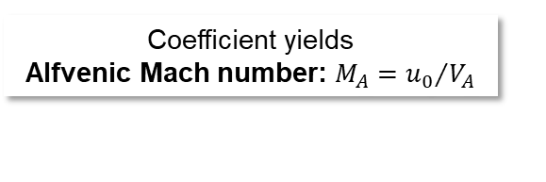
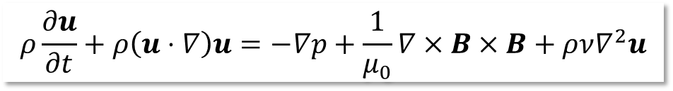
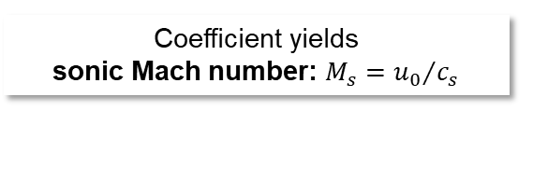
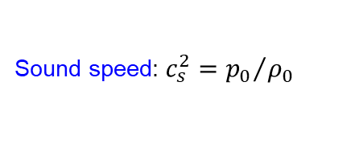
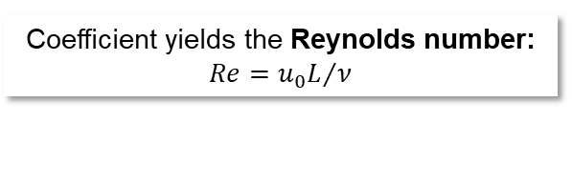
MHD scaling: momentum equation
$$ρ\frac{∂u}{∂t}+ρ\left(u⋅∇\right)u=−∇p+\frac{1}{μ_{0}}∇×B×B+ρν∇^{2}u$$
The conservation of momentum is
$$ρ=ρ_{0}\hat{ρ};u=u_{0}\hat{u};p=p_{0}\hat{p};B=B_{0}\hat{B}$$
$$∇=\frac{1}{L}\hat{∇}; \frac{∂}{∂t}=\frac{u_{0}}{L}\frac{∂}{∂\hat{t}}$$
Fluid + field parameters
Introducing scaling variables
Differential operators
Solving for dimensionless left-hand-side (good homework)
$\hat{ρ}\frac{∂\hat{u}}{∂\hat{t}}+\hat{ρ}$($\hat{u}⋅\hat{∇})\hat{u}=−\frac{p_{0}}{ρ_{0}}\frac{1}{u_{0}^{2}}\hat{∇}\hat{p} + \left(\frac{B_{0}^{2}}{μ_{0}ρ_{0}}\right)\frac{1}{u_{0}^{2}}\hat{∇}×\hat{B}×\hat{B} + \frac{ν}{u_{0}L}\hat{ρ}{\hat{∇}}^{2}\hat{u}$
Sound speed: $c_{s}^{2}={p_{0}}/{ρ_{0}}$
Alfven velocity: $V_{A}={B_{0}}/{\sqrt{μ_{0}ρ_{0}}}$
Viscous term is the only one with spatial scales
Coefficient yields
sonic Mach number: $M_{s}={u_{0}}/{c_{s}}$
Coefficient yields
Alfvenic Mach number: $M_{A}={u_{0}}/{V_{A}}$
Coefficient yields the Reynolds number: $Re={u_{0}L}/ν$
In the limit $Re≫1$, momentum is conserved on (global) scales $L,$and the momentum equation is scale-invariant
Ryutov et al., Astrophys. J. (1999); Cross et al., Astrophys. J. (2016)
Theory: MHD scaling

Slide 20
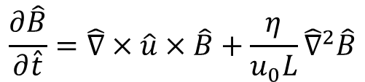
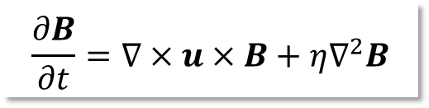
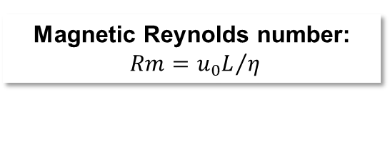
MHD scaling: induction equation
$$\frac{∂B}{∂t}=∇×u×B+η∇^{2}B$$
The evolution of the magnetic field is
$$\frac{∂\hat{B}}{∂\hat{t}}=\hat{∇}×\hat{u}×\hat{B}+\frac{η}{u_{0}L}{\hat{∇}}^{2}\hat{B}$$
The dimensionless induction equation becomes (again, homework)
Resistive term is the only one with spatial scales
Magnetic Reynolds number:
$Rm={u_{0}L}/η$
Resistive dissipation breaks the frozen-in condition of ideal MHD
In the limit $Rm≫1$, the magnetic field is coupled to the fluid on scales $L,$
and the induction equation is scale-invariant
Ryutov et al., Astrophys. J. (1999); Cross et al., Astrophys. J. (2016)
Theory: MHD scaling

Slide 21


MHD scaling: internal energy equation
$$\frac{∂p}{∂t}+\left(u⋅∇\right)p=−γp\left(∇⋅u\right)+χ∇^{2}p$$
Adiabatic energy conservation
Scales are coupled only to the Peclet number:
$Pe={u_{0}L}/χ$
In the limit $Pe≫1$, heat is advected along the flow, thermal diffusion is negligible on scales $L,$
and the energy equation is scale-invariant
Ryutov et al., Astrophys. J. (1999); Cross et al., Astrophys. J. (2016)
Theory: MHD scaling

Slide 22





MHD scaling is based on comparing a small set of dimensionless parameters in the lab and astrophysics
Dimensionless parameters
$$M_{s}, M_{A}, β, Re, Rm, Pe$$
Sonic Mach number:
$$M_{s}=\frac{u_{0}}{c_{s}}$$
Compare flow speed to internal propagation of information
Formation of (HD/MHD) shock waves
Buoyancy
Alfvenic Mach number:
$$M_{A}=\frac{u_{0}}{V_{A}}$$
Supersonic (M_{s} >1 ) fighter jet creating a shock in the atmosphere
Related to the partition of internal and magnetic energy density, plasma-β parameter
$$β≡p/{p_{M}; p_{M}≡{B^{2}}/{2μ_{0}; β=2{M_{A}^{2}}/{M_{s}^{2}}}}$$
Ryutov et al., Astrophys. J. (1999); Cross et al., Astrophys. J. (2016)
Theory: MHD scaling

Slide 23





Plasma flows are scale invariant when dissipation is negligible
Dimensionless parameters
$$M_{s}, M_{A}, β, Re, Rm, Pe$$
Reynolds number:
$$Re=\frac{u_{0}L}{ν}$$
“Dimensionless viscosity”:
Ratio of inertial to viscous forces
Dissipation sets a particular length-scale through terms of the form
$$∝D∇^{2}v,$$
breaking scale-invariance. Because of the Laplacian, when dissipation is a “small” number, it can only act on small scales << global scales
Magnetic Reynolds number:
$$Rm=\frac{u_{0}L}{η}$$
“Dimensionless resistivity”:
Ratio of magnetic advection vs
diffusion
Peclet number:
$$Pe=\frac{u_{0}L}{χ}$$
“Dimensionless heat diffusivity”:
Ratio of heat advection vs diffusion
Ryutov et al., Astrophys. J. (1999); Cross et al., Astrophys. J. (2016)
Theory: MHD scaling

Slide 24


Dimensionless numbers in the universe, the laboratory, and numerical simulations
Ideal MHD: Rm >> 1; Re >> 1
(frozen-in B-field)
$$Rm= \frac{u_{0}L}{η}∝\frac{L⋅T^{2}}{Z\sqrt{A}}≫1$$
 | Astro | Lab
Rm | >10¹⁰ | 10³
Re | >10¹⁰ | 10⁵
Simulations
10-10³
10-10⁴
(negligible viscosity)
$$Re= \frac{u_{0}L}{ν}∝\frac{L⋅Z^{4}⋅n_{i}}{T^{2}}≫1$$
(A=12, Z=6, M_{S}=3)
Large nT ➔ HEDP
(there are non-HEDP lab astro experiments, but they are large!)
Ryutov et al., Astrophys. J. (1999); Cross et al., Astrophys. J. (2016)
Theory: MHD scaling

Slide 25




Dimensionless parameters as ratios of length- and time-scales
A modern approach is to calculate dissipation time- and length-scales
They are measurable in experiments (unlike dimensionless parameters), so they are practical/useful
Viscous timescale
$$Re=\frac{u_{0}L}{ν}=\frac{{u_{0}}/L}{ν/{L^{2}}}=\frac{1/{t_{0}}}{1/{τ_{ν}}}=\frac{τ_{ν}}{t_{0}}$$
Ex: take the Reynolds number
$$Re≫1↔τ_{ν}≫t_{0}$$
Conclusion: When Re is large compared to unity, time for viscous damping is much greater than hydrodynamic time. Viscosity is inefficient at dissipating large-scale momentum.
Associated with this timescale there is a viscous length $ℓ_{ν}$ at which large-scale momentum is dissipated
$$τ_{ν}(L=ℓ_{ν})∼t_{0} ↔ \frac{ℓ_{ν}^{2}}{ν}∼\frac{L}{u_{0}} ↔ ℓ_{ν}^{2}=\frac{ν}{u_{0}L}L^{2}$$
$$ℓ_{ν}=Re^{{−1}/2}L$$
$Re≫1→ℓ_{ν}≪L$ : viscosity operates on small scales
Homework: what are the equivalent interpretations for $Rm$ and $Pe$?
Ryutov et al., Astrophys. J. (1999); Cross et al., Astrophys. J. (2016)
Theory: MHD scaling

Slide 26
In summary: what is the goal of dynamical laboratory astrophysics? (and what isn’t)
Dynamical laboratory astrophysics: study of evolution of astrophysics-relevant plasma flows from well-known initial conditions
Simplify a complicated astrophysics system, then make sure scaling is appropriate (MHD, collisionless, Braginskii, etc)
Make sure you measure all useful parameters: what is their structure? How do they evolve? This is what is interesting
The universe is very large!
  Even if you realize after the experiment that you targeted the wrong system initially, there probably is another system you can compare to
  Collaboration with astronomers/astrophysicists helps
Laboratory astrophysics is not:
  Recreation of full astrophysical systems
  A loose morphological comparison between lab and astro (“this looks like that”)
Introduction: laboratory plasma astrophysics

Slide 27
Selected Topics
(the good stuff)

Slide 28

Plasma jets in the universe

Slide 29

Plasma jets are full of substructures but remain collimated on large scales
Protostellar jets
Few light-years across
Accretion into a protostar
Speed ~ 100’s km/s
Optical emission (atomic lines)
~1 ly
Protostar
(embedded in disk)
They ‘look’ similar…
Similar jet morphology
Jets originate from a central source
Spatial features along jet (shocks, knots)
Terminal bow shocks
HH212
(ESO / M. McCaughrean)
Extragalactic jets
Thousands light-years across
Accretion into a supermassive black hole
Speed ~ light
Radio emission (synchrotron)
~10⁵ ly
Supermassive black hole
Cygnus A
(NRAO / AU)
Introduction: astrophysical jets

Slide 30

Plasma jets are multi-scale where different regions should be treated with a different approximation
“Hydrodynamic” jet (M>>1)
(resolved in observations)
(jet propagation,
interaction with interstellar medium)
Magnetic fields not important
Supersonic flow Radiatively cooled
Bow shock from jet-ambient interaction
Magnetically-driven jet
(theory)
Strong magnetic fields
Highly-collimated jet
Episodic ejections?
Launching region
(central source & accretion disk)
Outflow region - hydrodynamic jet
Frank et al., in: Protostars and Planets IV (2014); arXiv:14023553
Introduction: astrophysical jets

Slide 31


Far from the source, in the hydrodynamical stage, jets can be collimated by conical shocks
[ Canto et al., A&A 1988 ] [Bally et al., ApJ 2003]
Standing conical shock
Converging supersonic conical flow
Cooling parameter:
ratio of radiative cooling time to hydrodynamic time
Introduction: cooling effects in conical jets

Slide 32
Pulsed-power experiments have shown the effect of radiative cooling in the structure of jets
Radiative cooling affects jet collimation
  Converging plasma flow, re-directed by a standing conical shock
  Radiatively cooled jet, M >10, χ <1
  Jet velocity ~ 200km/s
  Electron density 10¹⁸-10¹⁹ cm⁻³
  λ/R <10⁻⁴ Re > 10⁴ Pe > 10-50
Stronger cooling
Lebedev et al., ApJ 2002
Results: cooling effects in conical jets

Slide 33


Magnetically-driven jets can be created by using foils in pulsed-power experiments
Al 6μm foil
Magnetically confined jet on the axis of magnetic cavity expanding through ambient plasma
Lebedev et al, MNRAS (2005), Ciardi et al, ApJL (2009), Suzuki-Vidal et al, PoP (2010, 2012)
Introduction: MHD jets

Slide 34





Well-known initial conditions in the experiments allow comparing with astrophysics codes
Simulations with laboratory code (GORGON)
Ciardi et al, PoP 2007
Astrophysical code (ASTROBEAR)
Huarte-Espinosa et al, 2012
Magnetic cavity (β <<1) with dense jet on axis (β ~1)
MHD instabilities, change of magnetic field topology (B_{ϕ} ➔ B_{z} , B_{r} )
Energy balance: Poynting flux, magnetic energy, kinetic energy, radiation.
Simulations: MHD instabilities in jets

Slide 35

MHD instabilities can develop gradually over the evolution of the jet
H. Calamy et al, 2007
XUV emission
30 mm
Lebedev et al, 2005
Instabilities produce “clumps” in the jet, but do not destroy collimation
Results: MHD instabilities in jets

Slide 36
Descriptive title
Experiment versus 3-D MHD
Ciardi et al, PoP 2007
Jet driven by the pressure of the toroidal magnetic field
Collimation of the central jet by the hoop stress
Collimation of the magnetic bubble by the ambient medium
Two temporal scales for outflow variability:
fast – instability growth time ( ~1ns)
slow – bubble growth time ( ~50ns)
Instabilities do not destroy the jet but produce a clumpy outflow
268ns 278ns 288ns 298ns
n_{i} ~ 10¹⁹ cm⁻³, T ~ 200 eV,
I ~ 1 MA, B ~ 100 T
Re > 10⁴ , λ/R ~10⁻⁵ , Pe > 10
β ~ 1, Re_{M} ~ 50-300
Results: MHD instabilities in jets

Slide 37

Turbulent flows in a neutral fluid (liquid or gas)
Turbulence
Laminar flow
Instability
Van Dyke, An Album of Fluid Motion (1988)
Introduction: turbulence

Slide 38


In a plasma, magnetic fields are entrained with the turbulence, producing much more complicated systems
Dynamo: Magnetic fields can be amplified by line stretching (shear, compression, rotation)
Beattie et al., Phys. Rev. Lett. (2025, in review)
Introduction: MHD turbulence

Slide 39



The TDYNO experiments create magnetized turbulence using lasers
Tzeferacos et al., Nat. Comm. (2018); White et al., Nat. Comm. (2019); Bott et al., PNAS (2021)
Results: MHD turbulence

Slide 40


First demonstration of fluctuation turbulent dynamo in the laboratory
LMJ-PETAL experiment: Bott et al, 2018
B-field reconstruction from proton probing
Results: MHD turbulence

Slide 41

Magnetic reconnection is a common process in the universe that energizes the fluid from the field
Magnetic reconnection driven explosion on the surface of the Sun
B
Plasma inflow 2
Plasma inflow 1
V_{out}
V_{out}
V_{in}
Current sheet
V_{in}
B
[Shibata+ 1995]
Introduction: magnetic reconnection

Slide 42










The Sweet-Parker model of magnetic reconnection
# of lines out
# of lines in
Conservation of mass:
Reconnection rate:
$$=\frac{V_{out}}{V_{in}}$$
$$→\frac{L}{δ}=\frac{V_{A}}{V_{in}}$$
$$ρV_{in}L=ρV_{out}δ$$
Conservation of energy:
(max outwards speed)
$$\frac{B^{2}}{2μ_{0}}=\frac{1}{2}ρV_{out}^{2}→V_{out}=\frac{B}{\sqrt{μ_{0}ρ}}≡V_{A}$$
Ampere’s law:
$$J_{z}\sim B/μ_{0}δ$$
Ohm’s law
$$E+u×B=ηJ$$
$$→V_{in}B=ηJ_{z}$$
$$→ \frac{V_{out}}{V_{in}}={\left(\frac{μ_{0}{LV}_{A}}{ η}\right)}^{1/2}≡S^{1/2}$$
1. $S$ is called Lundquist number, it is dimensionless (universal), and sets the reconnection rate
2. SP magnetic reconnection dissipates energy through Spitzer resistivity
Loureiro & Uzdensky, Plasma Phys. Control. Fusion (2015); Hare, PhD Thesis (2017)
Theory: magnetic reconnection

Slide 43


Magnetic reconnection can be chaotic, bursty, and explosive when plasmoids are formed
$$S∼\frac{L⋅B⋅T_{e}^{3/2}}{\sqrt{n_{e}}}>S_{c}$$
[Hare PhD Thesis 2017]
Current sheet length L is not a free parameter in Sweet-Parker reconnection
Loureiro & Uzdensky, Plasma Phys. Control. Fusion (2015); ; Hare, PhD Thesis (2017)
Introduction: plasmoids

Slide 44



Plasmoid reconnection has been observed in pulsed-power experiments
Stable SP with aluminium plasma experiments
[Suttle+ 2016]
Plasmoid unstable layer in carbon plasma
[Hare+ 2017]
Pulsed-power magnetic reconnection experiments
field of view
[Suttle+ 2016]
reconnection layer
B
B
$$S=20$$
$$S=120$$
Results: plasmoids

Slide 45




Magnetic reconnection in laser-driven experiments
Willingdale et al., Phys. Rev. Lett. (2010)
Introduction: laser-driven reconnection

Slide 46


Plasmoid reconnection in laser-driven experiments
Pearcy et al., Phys. Rev. Lett (2024)
Results: plasmoids in laser-driven reconnection

Slide 47

Magnetized shocks in the universe
Introduction: astrophysical shock waves

Slide 48



Observations of the transition from the heliosphere have shown a continuous shock around the solar system
Subcritical shock
(low Mach number)
“smooth” jump
$ρ$, B
T_{i}
Resistive diffusion length
Burlanga et al., Astrophys. J. Lett. 2013
Introduction: subcritical shock waves

Slide 49


Magnetic fields and dissipation can drastically change the shape of a shock
Ideal MHD shock
Plasma Flow
$ρ$, B
$$λ_{i,i}$$
Slide credit: Danny Russell (Imperial)
Introduction: subcritical shock waves

Slide 50

Magnetic fields and dissipation can drastically change the shape of a shock
Ideal MHD shock
Resistive MHD shock
(high Mach number)
Plasma Flow
T_{i}
$ρ$, B
$ρ$, B
$$λ_{i,i}$$
Iso-magnetic jump
Slide credit: Danny Russell (Imperial)
Introduction: subcritical shock waves

Slide 51

Magnetic fields and dissipation can drastically change the shape of a shock
Ideal MHD shock
Resistive MHD shock
(high Mach number)
Subcritical shock
(low Mach number)
Plasma Flow
T_{i}
$ρ$, B
$ρ$, B
T_{i}
$ρ$, B
$$λ_{i,i}$$
Iso-magnetic jump
Resistive diffusion length
Slide credit: Danny Russell (Imperial)
Introduction: subcritical shock waves

Slide 52



To create subcritical shocks, an exploder wire array blew magnetized plasma winds onto two cylindrical obstacles
A supersonic, super-Alfvénic Plasma Flow with a frozen in B – Field is accelerated by the J$×$ B force
Plasma Flow
Wires
B - Field
Obstacles
Current
Z
${\text{n}}_{\text{e}}\text{=1 }\text{×} {\text{10}}^{\text{18}} {\text{cm}}^{\text{−3}} \text{, }\text{T}\text{=12 }\text{eV}\text{,} \text{V}\text{=45 }\text{km}{\text{s}}^{\text{−1}}$ B = 1.5-2.5 T
M_{MS} = 1.9 ${\text{β}}_{\text{th}}\text{=}{{\text{P}}_{\text{th}}}/{{\text{P}}_{\text{mag}}}\text{=1.7}$
X
Russell et al., Phys. Rev. Lett. (2022); Journal Plasma Phys. (2023)
Results: subcritical shocks

Slide 53


The results show the formation of subcritical shocks where dissipation is given by resistivity
Shock width ~ resistive scale
Transition always happens at Rm = 1!
Russell et al., Phys. Rev. Lett. (2022); Journal Plasma Phys. (2023)
Results: subcritical shocks

Slide 54



Often shocks in astrophysics are collisionless
Supernova Remnant SN 1006
Common features of collisionless shocks
Hierarchy of length-scales
$$λ_{mfp}^{i\backslash i} ≫ L_{n}$$
Interactions are mediated by collective EM fields
Efficient ultra high-energy particle accelerators
B₀
Shocks
Ion-ion
mean free path
Density gradient
length-scale
$λ_{mfp}^{i\backslash i}∼10$ lyr
Marcowith et al. Rep. Prog. Phys. (2016)
Introduction: collisionless shocks

Slide 55



Experiments at OMEGA and the NIF have created collisionless shocks mediated by the Weibel instability
Park et al., Phys. Plasmas (2015); Huntington et al., Nature Phys. (2015)
Results: collisionless shocks

Slide 56


Experiments at the NIF have created fully-developed Weibel-mediated shocks
Fiuza et al., Nat. Phys (2020)
Results: collisionless shocks

Slide 57


Conclusions
HEDP facilities can create macroscopic quantities of matter at astrophysical conditions
Dynamical laboratory experiments:
  benchmarking hydrodynamics (compressible), radiation-hydrodynamics, magneto-hydrodynamics codes under scalable conditions.
  laboratory experiments may prompt the emergence of new concepts
The “Grand Challenge”: ability to measure all required parameters (n, T, V_{flow}, B, etc.), instead of inferring them from computer models
Conclusions and final remarks

